Slide 1
CS 3186
Context-Free Languages
Section 5.1

Slide 2
Language hierarchy
In the previous chapter, we saw that there are languages that are not regular and belong to a larger family of languages.
Context-Free is the next level in the family of languages.
In the next few chapters, we explore the relationships between languages (context-free languages), grammars (context-free grammars) and automata (pushdown automata).
Context-free languages are very important because many practical aspects of programming languages are in this family.

Slide 3

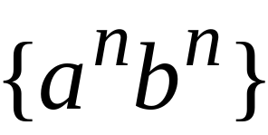
Language hierarchy
Context-Free Languages
Regular Languages

Slide 4
Languages, Grammars, Automata
Context-Free Languages
Context-Free
Grammars
Pushdown
Automata
stack
automaton

Slide 5
Context-Free Grammars

Slide 6

Grammars
Recall (Chapter 1) that a grammar is defined by the quadruple G = (V, T, S, P)
Recall (Chapter 3) that a regular grammars, there is a severe restriction on the production rules (P). i.e., for a rule of the form
x can only be one variable
Y can contain only have at most one variable and more restriction on where the variable can occur for a right-linear grammar or a left-linear grammar.
For context-free grammars, we maintain the left-side restriction but relax the restriction on the right side.

Slide 7


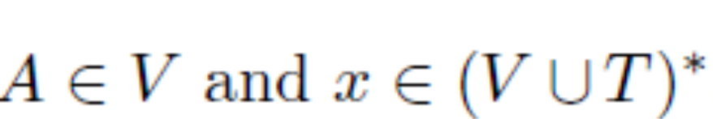
Context-Free Grammars
Definition: A Context-Free Grammar is defined as:
Variables
Terminal
symbols
Start
variable
Productions of the form:
Variable
String of variables and terminals

Slide 8

Context-Free Grammars
Language generated by the grammar G, L(G), is the set of all strings that can be generated from the start symbol S using the productions P.

Slide 9


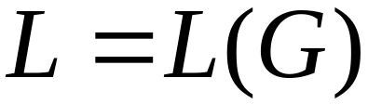
Context-Free Languages
Definition:
A language is context-free
if and only if
there is a context-free grammar
with

Slide 10
Note
The family of regular languages is a subset of the family of context-free languages! (i.e., every regular language is a context-free language)
Every regular grammar is a context-free grammar as the production rules of a regular grammar are more restrictive than the context-free grammars.

Slide 11
Context-free grammars
A derivation of some sentence is a sequence
The strings S, w₁, · · · , w_{n} above are sentential forms of the derivation of sentence w.
In generating a sentential form, a production rule is applied by replacing the variable in the sentential form by the right side of a production (with no dependencies on other symbols in the sentential form)

Slide 12

Example-1
A context-free grammar :
A derivation:
Observations:
• a and b are always generated equally
• a’s precedes the b’s in the derivation.

Slide 13


A context-free grammar :
Another derivation:
From the derivations, we see that

Slide 14
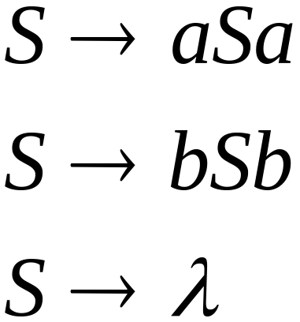
Example-2
A context-free grammar :
A derivation:
Observations:
• a and b are generated synchronously on the left and right in any derivation.
• Palindromic fashion

Slide 15

A context-free grammar :
Another derivation:
From the derivations, we see that

Slide 16
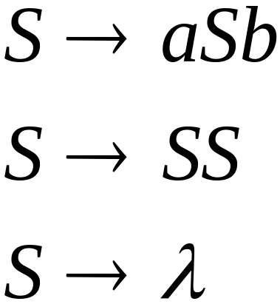
Example-3
A context-free grammar :
Sample derivations:
Observations:
• a and b are always generated in pairs.
• a precedes the matching b.
• prefix of a string may contain several more a’s than b’s.

Slide 17
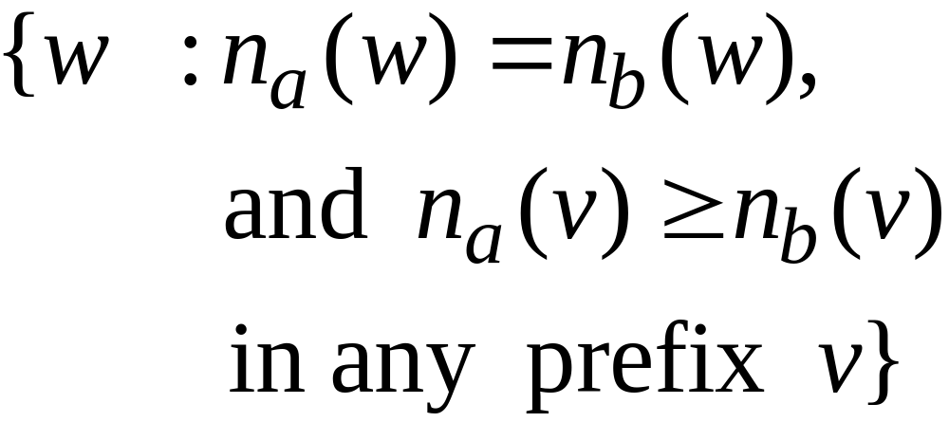
If ‘a’ and ‘b’ are replaced by ‘(‘ and ‘)’, the
Language describes properly nested parentheses.
For example:
() ((( ))) (( ))

Slide 18
Note
All the three examples (Example-1, Example-2, and Example-3 were all proven to be non-regular.
Example-1 and Example-2 fits the description of a linear grammar while Example-3 is a non-linear grammar.
All the three examples fit into the description of context-free grammars and languages.
All linear grammars are Context-free grammars while not all context-free grammars are linear grammars.

Slide 19
Derivation
Consider a grammar G = ({S, A, B, C}, {a, b, c}, S, P)
A derivation starts with
S ABC as a sentential form
In each step, any variable in the sentential form can be replaced. i.e., either A, B, or C in the above sentence can be replaced.
Any such replacement yields the same sentence using exactly the same productions.
We often require that the variables be replaced in a specific order.

Slide 20
Derivation Order
Definition : Leftmost and Rightmost Derivations
A derivation is leftmost if, in each step, the leftmost variable in the sentential form is replaced.
A derivation is rightmost if, in each step, the rightmost variable in the sentential form is replaced

Slide 21
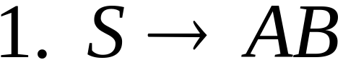
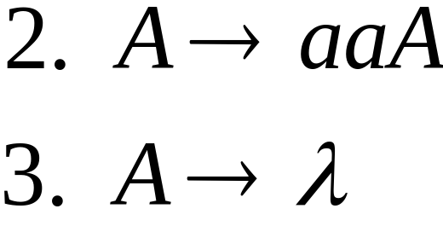
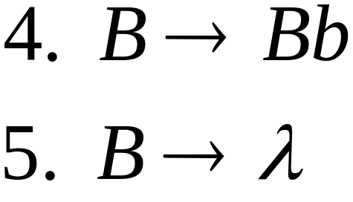


Derivation Order Example
Given the production rules:
Leftmost derivation:
Rightmost derivation:

Slide 22
Note
Both these derivations yield the same sentence using exactly the same productions.
However, the productions are applied in different orders.
If the grammar is a linear grammar, each sentential form has at most one variable. Hence there is never any choice about which variable to expand next.

Slide 23
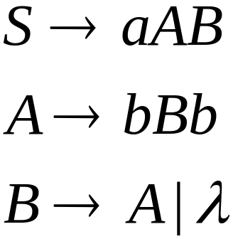
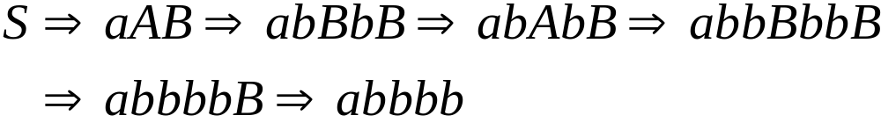
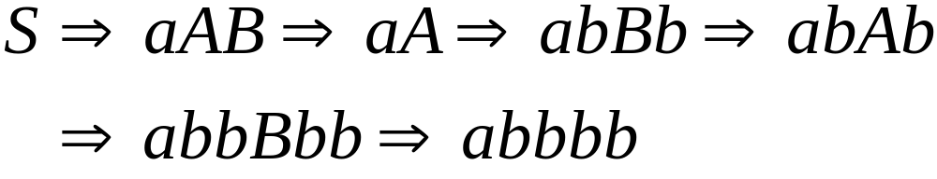
Another Example
Leftmost derivation:
Rightmost derivation:

Slide 24

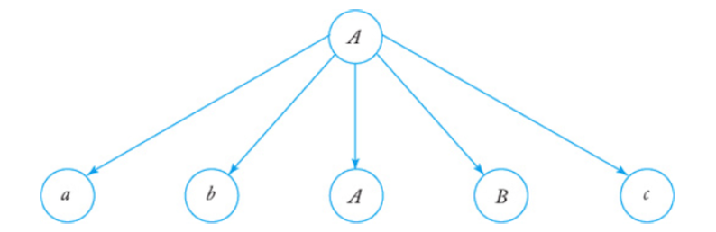
Derivation Trees
A derivation tree is an ordered tree in which we label the nodes with the left sides of productions and the children of a node represent its corresponding right sides.
The Production is reflected/visualized in a derivation tree as:

Slide 25
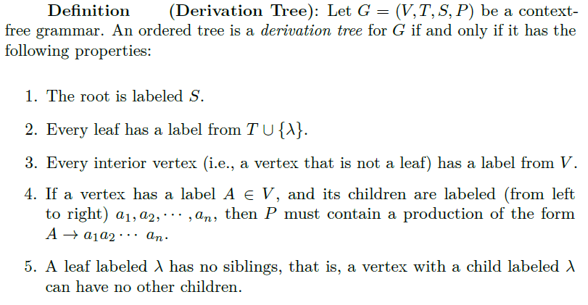
Derivation Trees

Slide 26

Derivation Trees
A derivation tree shows derivations applying the production rules. Derivation trees give explicit (and visualizable) descriptions of derivations.
The intermediate trees formed during the derivation steps is referred to as a partial derivation tree. i.e., when the leaf nodes are
The partial derivation tree is a representation of the sentential form in the derivation sequence.

Slide 27
Derivation Trees - Yield
In a derivation tree, if we read the leaves of a tree from left to right, omitting any ’s encountered, we obtain a string called the yield of the tree.

Slide 28
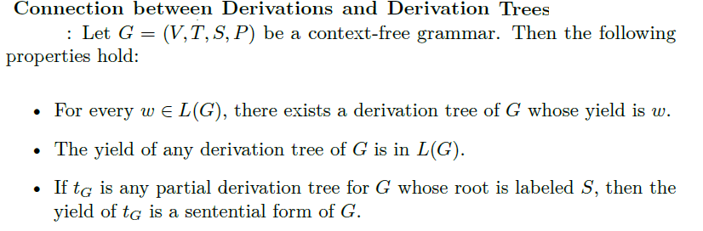
Derivations & Derivation Trees

Slide 29

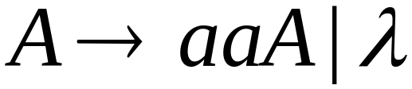
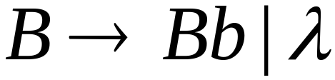




Example
Given a grammar G:
Sentential form:
Partial Derivation Tree:
Yield: AB

Slide 30


Sentential form:
Partial Derivation Tree:
Yield: aaAB

Slide 31

Sentential form:
Partial Derivation Tree:
Yield: aaABb

Slide 32
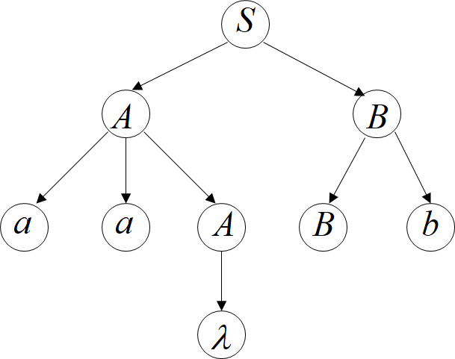

Sentential form:
Partial Derivation Tree:
Yield:

Slide 33


Sentential form:
Derivation Tree:
Yield:

Slide 34
Derivation Tree
Derivation trees:
• show which productions are used to generate a sentence
• independent of the order in which individual productions are applied (leftmost or rightmost or in any order)
• For practical applications, order may be necessary. i.e., enable the construction of either a leftmost or rightmost derivation (i.e., you could generate the same derivation tree irrespective of applying the left-most or the right-most derivation at each step in the sentential form)

Slide 35

Example: Using the same grammar G:
Leftmost derivation:
Rightmost derivation:
Same derivation tree

Slide 36
(I) Do Exercises: # 1,2
(II) Consider the grammar G=({S,A,B},{a,b},S,P) where P:
S → bB / aA
A → b / bS / aAA
B → a / aS / bBB
For the string w = bbaababa,
(i) Using leftmost derivation, show step by step the partial derivation trees, yield for each of the sentential forms in deriving w
(ii) Repeat the same process for the rightmost derivation.
(iii) Is the derivation tree the same in both (i) and (ii) above?
(III) Consider a grammar G = ({S, A, B, C}, {a, b, c}, S, P)
For the string abbc
(i)Give the leftmost derivation and the derivation tree
(ii)Give the rightmost derivation and the derivation tree
Homework 5.1

Slide 37
CS3186
Parsing and Ambiguity
Section 5.2

Slide 38
Ambiguity

Slide 39
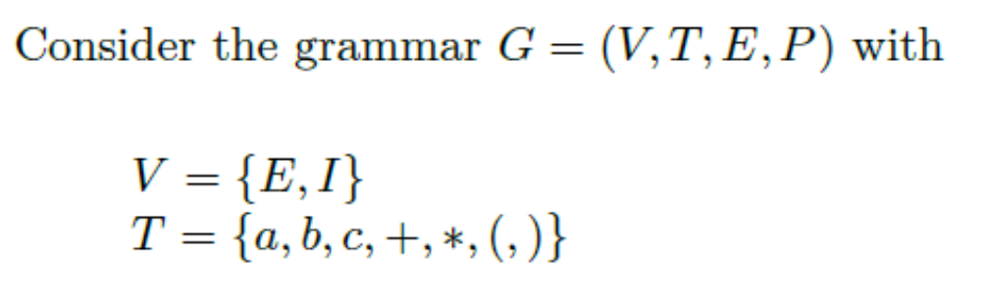
Ambiguity
E is the start non-terminal variable
P, the production rules, are:

Slide 40





Example: Derive the string
leftmost derivation
Derivation tree

Slide 41

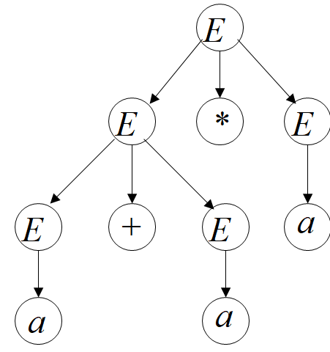
Another leftmost derivation for
Another Derivation tree

Slide 42
Two derivation trees on

Slide 43
Ambiguity
Since there are two derivation trees on the same string the grammar is ambiguous.
Each of the derivation tree could be a representation of leftmost or rightmost derivations.
Thus there are two leftmost and two rightmost derivations.

Slide 44
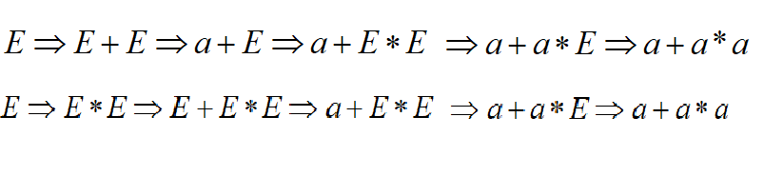
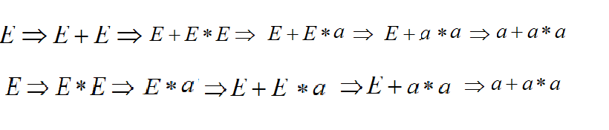
Ambiguity
String has two leftmost derivations
String also has two rightmost derivations

Slide 45

Ambiguity
Definition:
A context-free grammar is ambiguous
if some string has:
two or more derivation trees
two or more leftmost derivations
two or more rightmost derivations

Slide 46


Why do we care about ambiguity? The semantics (meaning) of the expression is also associated with the structure of the expression. The structure determines how to carry out the computation. For example:
take

Slide 47



Slide 48






Slide 49
Correct result:

Slide 50
Ambiguity can be resolved by using precedence rules by giving * a higher priority over +. This cannot be represented as a rule in the grammar as we had described.
However, we could in some instances rewrite the grammar to avoid the ambiguity.

Slide 51
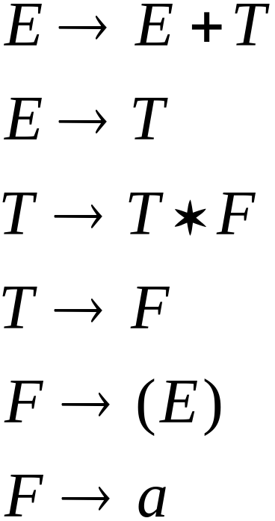
We fix the ambiguous grammar:
New non-ambiguous grammar:

Slide 52





Slide 53
Unique derivation tree

Slide 54
The grammar :
is non-ambiguous:
Every string has
a unique derivation tree

Slide 55

Another Ambiguous Grammar
(Dangling “else” problem)
Note the style of writing production rules
Lowercase descriptors are terminals.
Uppercase descriptors are variables/non-terminals
IF_STMT
if EXPR then STMT
if EXPR then STMT else STMT
Parse the statement:
If expr1 then if expr2 then stmt1 else stmt2

Slide 56
If expr1 then if expr2 then stmt1 else stmt2
IF_STMT
if
expr1
then
STMT
if
expr2
then
stmt1
else
stmt2
IF_STMT
if
expr1
then
STMT
else
stmt2
if
expr2
then
stmt1
Two different meanings above. The “else” can be paired by different “if” statements giving different meanings

Slide 57
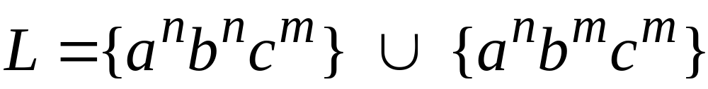

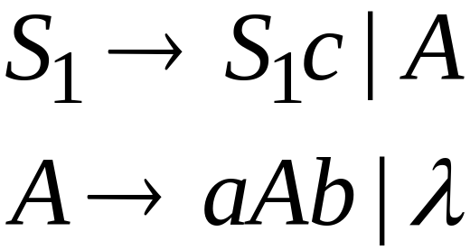
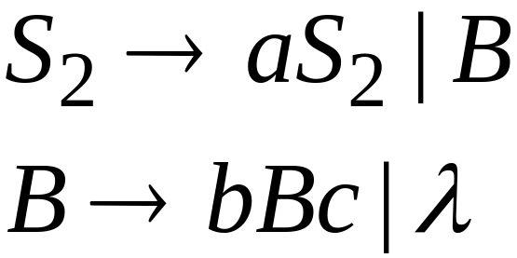
Inherent Ambiguity
Some context free languages
have only ambiguous grammars
Example:

Slide 58



The string abc
has at least two derivation trees:

Slide 59
Ambiguity is bad for programming languages
They give two different meanings on the same string

Slide 60


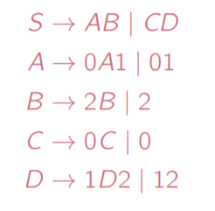
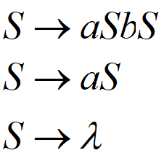
(I) Do Exercises: # 1,2,3,8, 10, 17, 18, 19
(II) Which of the following grammars are ambiguous: [If ambiguous, give two leftmost, two rightmost & two derivation trees]
(i)
(iv)
(ii) (v)
(vi)
(iii)
Homework 5.2

